Slide 1


MiNap
Sleep Diary
Presented by:
Anika Raisa Chowdhury
Max Liu
Raphael Chin
Quishi Zhao

Slide 2

Goal
Assist in capturing sleep data to facilitate sleep medicine studies.
Replace paper based sleep diaries. There would be two kinds of users:
Participants
Researchers

Slide 3
Features and User Story
Login from Mobile App
Record Sleep in Smart Watch
Review in Mobile App
Visualize collected on tableau (not for participants)

Slide 4
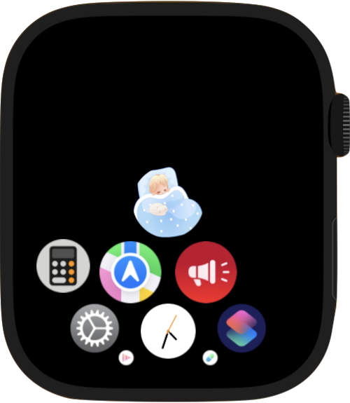

Front End
App Icon
This cute Minap icon allows participants to quickly recognize the app.
Smartwatch app

Slide 5
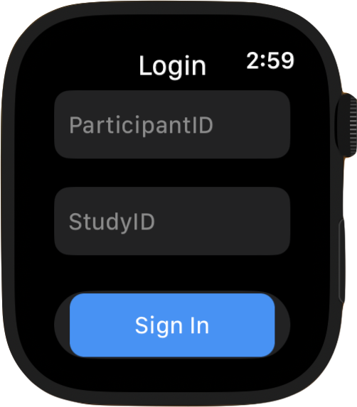
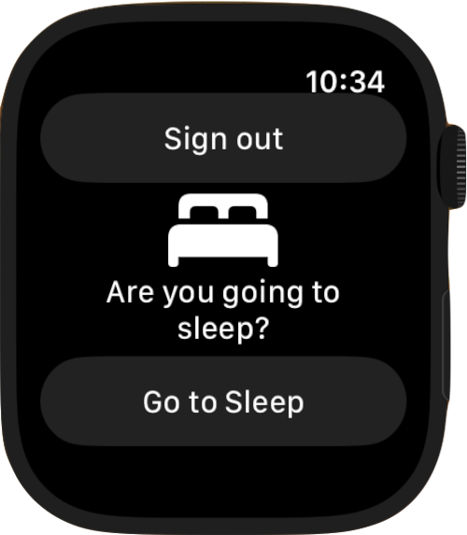
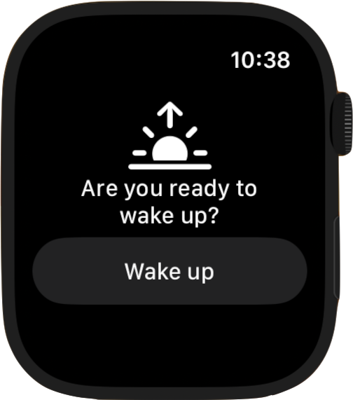
Front End
Login
Sleep Interface
Wake-Up Interface
Participants will input their participant IDs and Study IDs to login
Participants can press “Go to Sleep” before they sleep.
Sign out button is there if they decided to sign out.
Participants can press “Wake Up” when awake.
Sign out button is removed to prevent accidental sign out

Slide 6
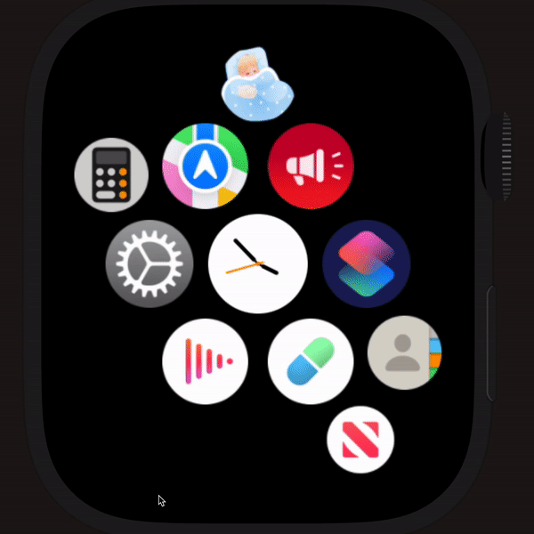
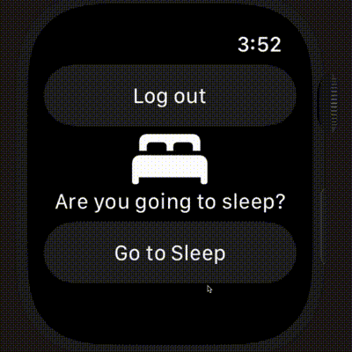
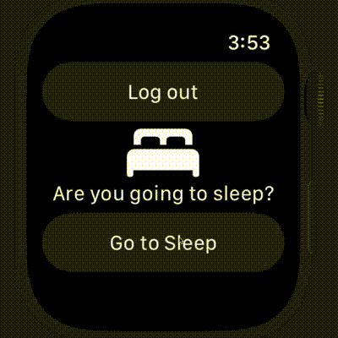
Demo - User Journey for Front End
Open app from Home and Login
Sleep Tracker:
Press “Go to Sleep” to record current sleep status, and press “Wake Up” to stop sleep track
Log Out
After recording a sleep session or when not tracking, please feel free to log out of the interface

Slide 7
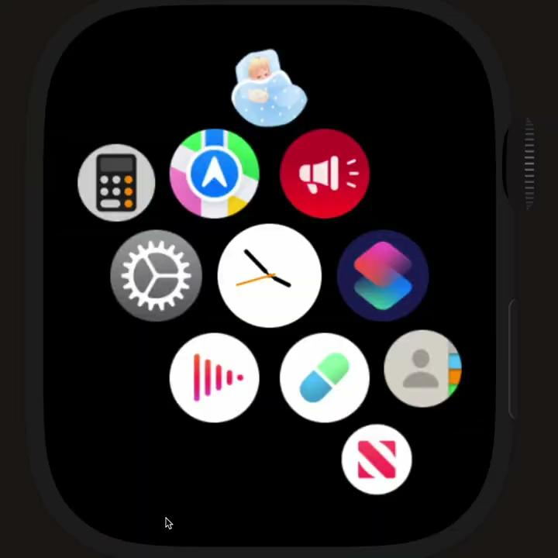
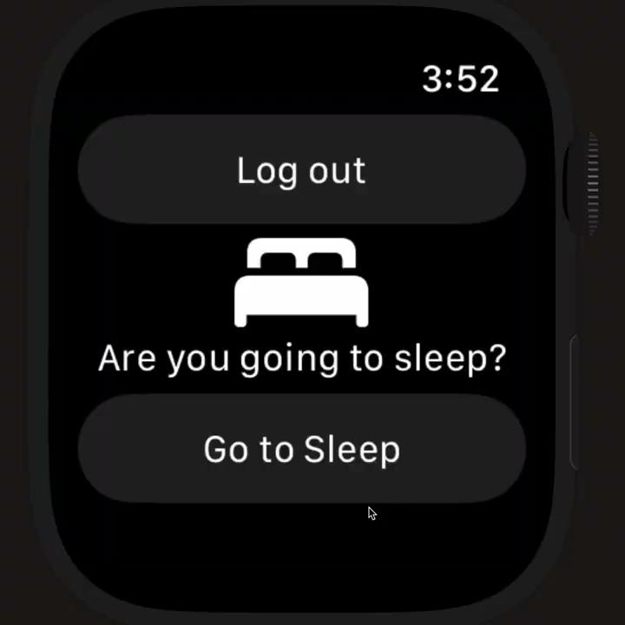
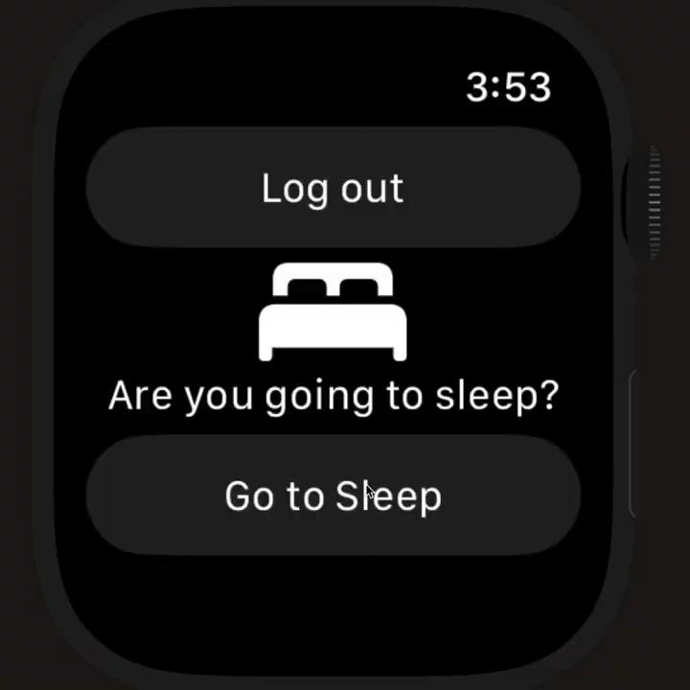
Demo - User Journey for Front End
Open app from Home and Login
Sleep Tracker:
Press “Go to Sleep” to record current sleep status, and press “Wake Up” to stop sleep track
Log Out
After recording a sleep session or when not tracking, please feel free to log out of the interface

Slide 8

Demo Recording -
User Journey
for Front End
Open app from Home and Login → Sleep Tracker → Log out Out (optional)

Slide 9
Demo Recording -
User Journey
for Mobile App
Open app and Login with Authentications → View Sleep Sessions on Dashboard → Fill in Survey questions

Slide 10
Backend Architecture of the Application
Main Components
Deployment
Stack
• GraphQL API
• Data persistent storage with AWS Datastore
• AWS DynamoDB - App Side
• Oracle DB - Med school secure storage
• Dockerized python script to sync between AWS and Oracle using database developer toolkit
Register backend of mobile app with AWS Amplify
Connect API to mobile app with AWS Appsync
Host Docker container script on MiServer for DB sync
Github: https://github.com/DepressionCenter/MiNap
Branch 1: Mobile - houses the code for the mobile app
Branch 2: frontend-new houses the codes for the iOS smartwatch app.
Swift
React Native
Python/SQL
Notes:
Talk about how the watch and the mobile app are communicating. Detail on the backend.

Slide 11
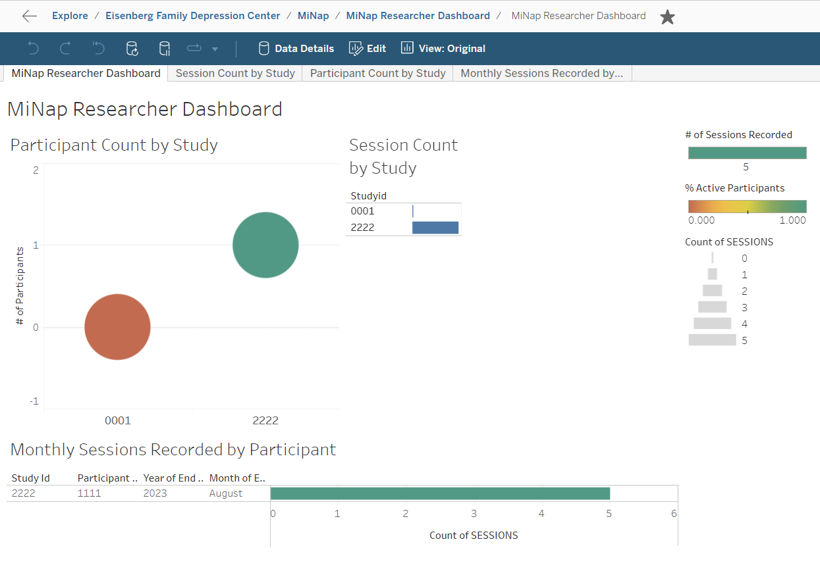
Researcher’s Dashboard
• Sleep pattern by a Participant
• Sleep pattern by Study id.

Slide 12
Future Scope
Extend to other platforms such as Garmin, Fitbit.
Develop access levels for the mobile application to facilitate real time data visualization for researchers.
Work on processing survey and history data when databases are syncing. Reflect the deletion of records immediately in mobile app.
Allow researchers to control sleep session data via mobile app more directly.

Slide 13
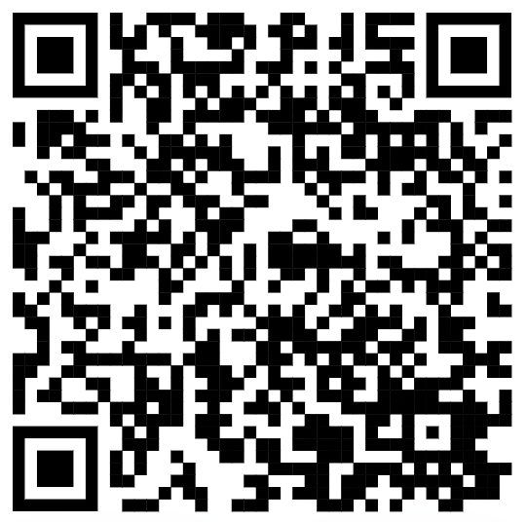
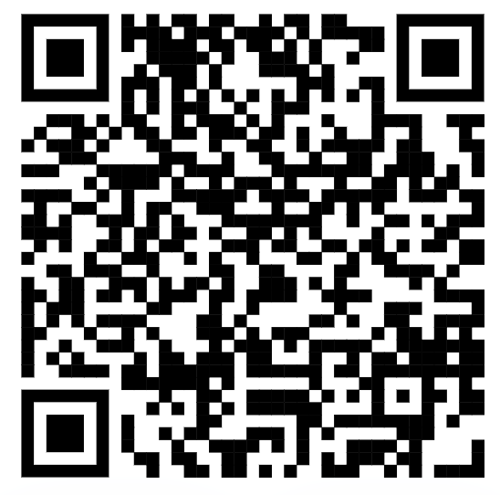
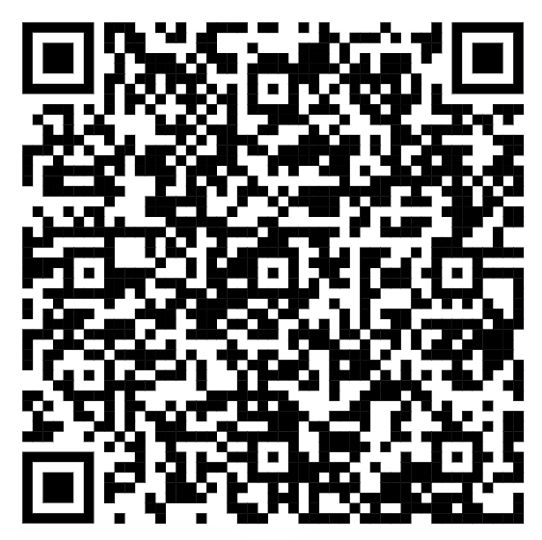
THANK YOU!
Contacts
Github
Knowledge Base
minap2023its@umich.edu
https://github.com/DepressionCenter/MiNap
https://teamdynamix.umich.edu/TDClient/210/Portal/KB/?CategoryID=885
Do you have any questions?

